Slide 1
Population Genetics Data Analysis
Jan 23, 2021

Slide 2
Content
HPCC and Linux
Reads alignment and genotyping
Calculating HWE

Slide 3
HPCC and Linux
High Performance Computer Center (HPCC)
Linux operating system

Slide 4
HPCC and Linux
Get an HPCC account
Linux training: Feb. 2 & 4, 10 am – 12 am; Mar. 2 & 4, 2 pm - 4 pm

Slide 5
HPCC and Linux
Detailed tutorial:
https://github.com/gudusanjiao/popgen2021/blob/main/HWE.md

Slide 6
Reads mapping and genotyping

Slide 7
Reads alignment and genotyping
Reference:
ATAAACCATGATGGCCCCACACGGTCCAGATTGATAACCACAGATCAGATTTAGTTATAGGT
Individual 1
ATAAAGCATGATGGCTCCACACGGTCCAGATTGATAACCACAGATCAGATTTAGGTATAGGT
Individual 2
ATAAAGCATGATGGCCCCACACGGTCCAGATTGATAACCACAGATCAGATTTAGGTATAGGT
Individual 3
ATAAAGCATGATGGCCCCACACGGTCCAGATTGATAACAACAGATCAGATTTAGATATAGGT
Individual 4
ATAAACCATGATGGCTCCACACGGTCCAGATTGATAACAACAGATCAGATTTAGTTATAGGT
Individual 5
ATAAACCATGATGGCTCCACACGGTCCAGATTGATAACAACAGATCAGATTTAGCTATAGGT
Individual 6
ATAAACCATGATGGCGCCACACGGTCCAGATTGATAACCACAGATCAGATTTAGCTATAGGT
Individual 7
ATAAAGCATGATGGCCCCACACGGTCCAGATTGATAACCACAGATCAGATTTAGATATAGGT
:
:
Individual N
ATAAAACATGATGGCCCCACACGGTCCAGATTGATAACCACAGATCAGATTTAGATATAGGT

Slide 8
Reads mapping and genotyping

Slide 9
Reads mapping and genotyping
48 raw sequencing data, .fastq
convert fastq files to uBam
FastqToSam
unaligned Bam, uBam
map sequencing data to S. purpurea genome
bwa, samtools
PacBio assembly of S. purpurea
aligned Bam, .bam
merge aligned and unaligned data
GATK MergeBamAlignment
merged bam, .bam

Slide 10
Reads mapping and genotyping
merged bam, .bam
sort, index, filter
picard
index, .bai filtered, bam
indel realignment
GATK IndelRealigner
realigned bam, .bam

Slide 11
Reads mapping and genotyping
48 realigned bam, .bam
SNP calling
GATK HaploCaller
variant file, .vcf
hard filtering
GATK FilterVariants
filtered variant file, .vcf

Slide 12
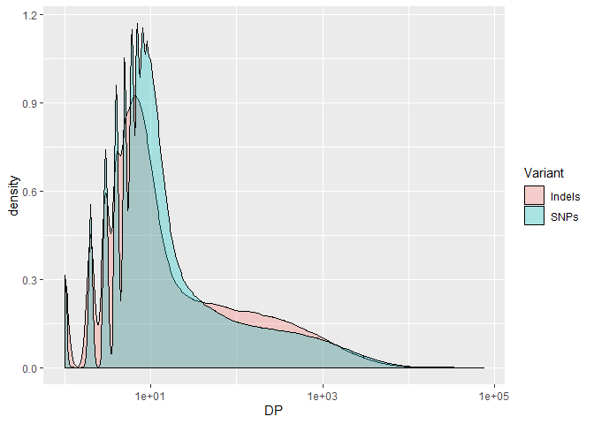
Reads mapping and genotyping
Filtering Criteria:
DP: Read Depth
unfiltered depth over all samples

Slide 13
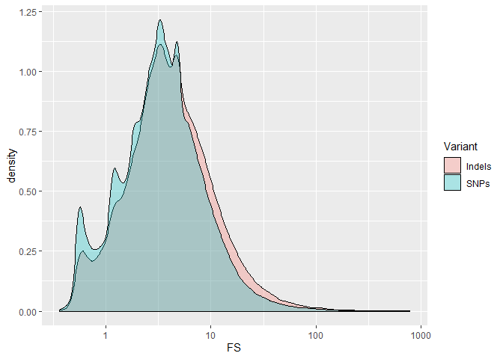
Reads mapping and genotyping
Filtering Criteria:
FS:
strand bias in support for REF vs ALT allele calls using a Fisher’s exact test

Slide 14
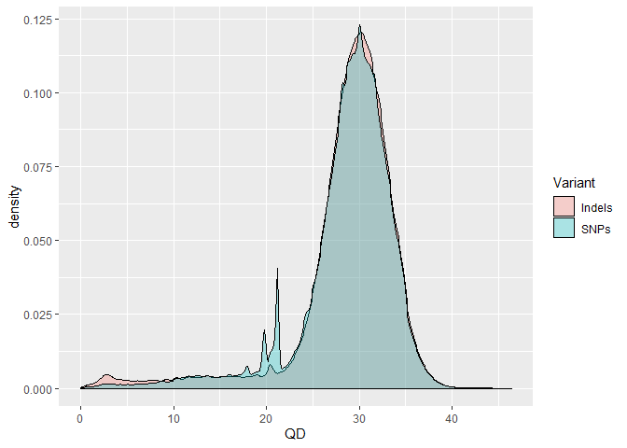
Reads mapping and genotyping
Filtering Criteria:
QD: Quality By Depth
Variant confidence normalized by unfiltered depth of variant samples

Slide 15
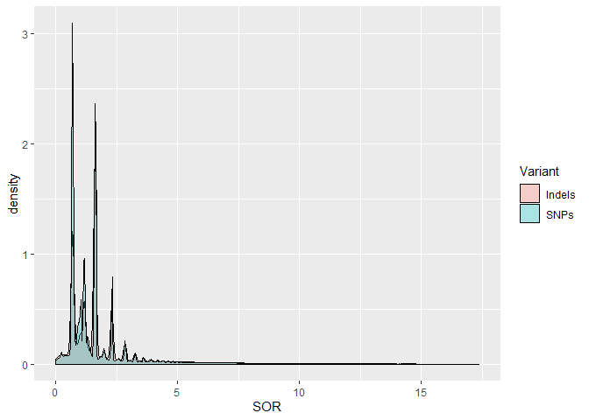
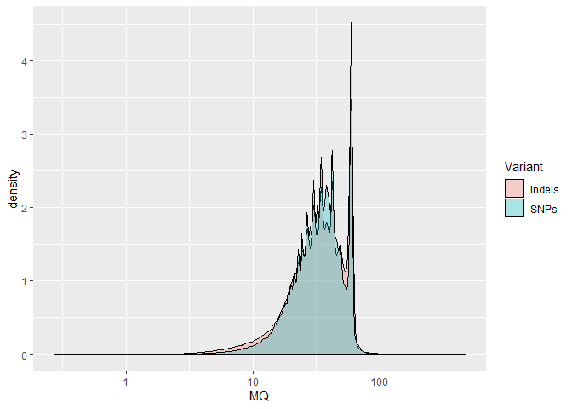
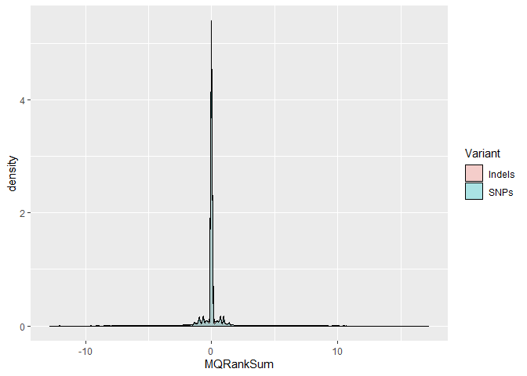
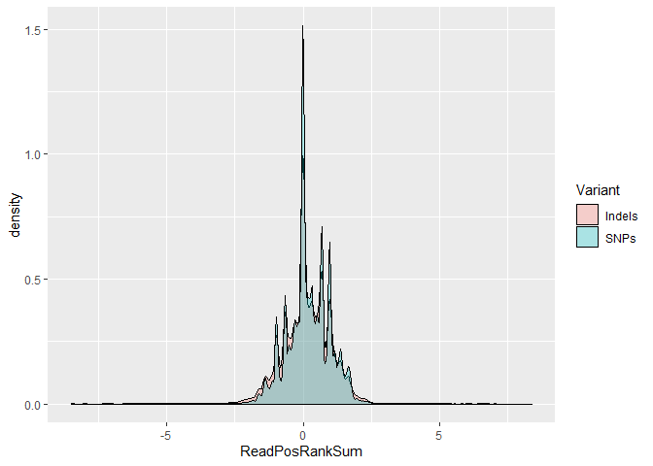
Reads mapping and genotyping
Filter out
DP < 6 & > 200
MQ < 20.00
SOR > 3.000
QD < 2.000
FS > 60.000
MQRankSum < -12.500
ReadPosRankSum < -8.000 & > 8.000
Genotypes for > 75% individuals

Slide 16
Reads mapping and genotyping
in some file types (e.g., VCF files …)
VCF file in BEAGLE5 form (columns reduced)
CHROM POS REF ALT SE887M SE889M SE890F SE891M SE892F SE893M SE894F SE897M
Chr15W 15809 G T 0|1 0|1 0|1 0|1 0|1 1|1 0|1 0|1
Chr15W 15917 T G,A 0|0 0|0 0|0 0|0 0|0 0|0 0|0 0|1
Chr15W 15920 G A 0|0 0|0 0|0 0|0 0|0 0|0 0|0 0|1
Chr15W 15921 C T 0|1 0|0 0|0 0|0 0|0 0|0 0|0 0|0
Chr15W 16000 C T 1|1 1|1 1|1 1|1 1|1 1|1 1|1 1|1
Chr15W 16115 A C 0|0 0|0 0|0 1|0 0|0 0|0 1|0 0|0
Chr15W 16125 T C 1|1 1|1 1|1 1|1 1|1 1|1 1|1 1|1
Chr15W 16129 G A 1|1 1|1 1|1 1|1 1|1 1|1 1|1 1|1
Chr15W 16152 T C 1|1 1|1 1|1 1|1 1|1 1|1 1|1 1|1
Chr15W 16156 G C 0|0 0|0 0|0 0|0 0|0 0|0 0|0 0|1
Chr15W 16174 T C 1|1 1|1 1|1 1|1 1|1 1|1 1|1 1|1
Chr15W 17876 C A,G 1|1 1|1 1|2 1|2 1|1 1|1 1|1 1|1
0: reference genotype
1, 2, 3: alternative genotypes

Slide 17
Calculating HWE

Slide 18
Calculating HWE
p² + 2pq + q² = 1
Testing HWE: Wigginton et al. (2005)

Slide 19
Calculating HWE
Angsd:
angsd -vcf-gl <vcf file> -doHWE 1
Chromo is the chromosome
Position is the position
hweFreq is the allele frequency assuming HWE (same as -doMaf 1)
Freq is the allele frequency without HWE assumption
F is the scale departure from HWE (inbreeding coefficient - see model)
LRT is the likelihood ratio statistic
p-value is the p-value based on a likelihood ratio test

Slide 20
Calculating HWE
vcftools:
vcftools --vcf <vcf file> --hardy --out <out file>
Contains the Observed numbers of Homozygotes and Heterozygotes and the corresponding Expected numbers under HWE.
vcftools manual
http://vcftools.sourceforge.net/man_latest.html

Slide 21
HPCC and Linux
Get an HPCC account
Linux training: Feb. 2 & 4, 10 am – 12 am; Mar. 2 & 4, 2 pm - 4 pm
Install ‘miniconda’ or ‘anaconda’
Use ‘conda’ to install ‘vcftools’
Install ‘angsd’ from https://github.com/ANGSD/angsd
Calculating HWE with statistical test for S. phlebophylla, S. nivalis, S. reticulata

